Slide 1
JavaScript Promises, async/await and eventloop
Hosted by: Shivraj Naghera (22CP303)

Slide 2
Outline
Definition of JavaScript
Some important terminology
Callbacks
Promises
Async/await
Eventloop

Slide 3
What is Javascript?

Slide 4
What is Javascript?
JavaScript is a scripting or programming language that allows you to implement complex features on web pages.
Javascript can be used to make webpage more dynamic and interactive.
Javascript is a single threaded non-blocking asynchronous concurrent programming language.
What is the meaning of concurrency?

Slide 5
Some terminology that should be known

Slide 6
Some terminology that should be known
What does asynchronous actually mean?
Some examples of asynchronous tasks
Server-side rendering
Client-side rendering
API (Application programming interface)
Rest APIs (Representational state transfer APIs)

Slide 7
Callbacks

Slide 8
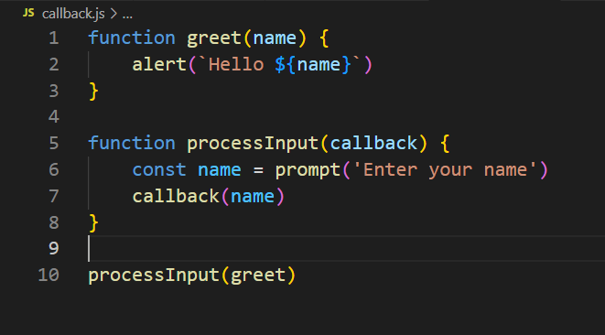
Callbacks
A callback function is a function passed into another function as a argument, which is then invoked inside the outer function to complete some kind of routine or action.
Generally used for the async tasks.

Slide 9
Callbacks (continued)
Before the other options came (like promises) we used to use the callbacks to handle the async tasks.
However there are many problems with the callbacks.
There are main two problems with this approach
First, we just need to trust that callback function will eventually be called and it will not call twice or even in incorrect order. So there is no trust in this approach.
Second and most important is the unreadability of the codebase. And creates a problem known as “callback hell”.

Slide 10
Callbacks (continued)
So we need some better approach.
That gives us more robust approach.
And is more user friendly.
Promise was introduce to solve this problem.

Slide 11
Promise

Slide 12
Promise
The Promise object represents the eventual completion (or failure) of an asynchronous operation and its resulting value.
Promise has two states: pending or completed.
After the completion Promise may get resolved or get rejected.
Since it is more common to use Promise rather than creating one ourselves, we will learn how to work with Promises.
Fetch API gives us ability to make HTTP request to HTTP endpoint and get the response. It is Promise based implementation.

Slide 13
Promise (continued)
There are few things that we noticed in the code
First, callbacks were not passed as arguments but are passed when promise gets resolved or rejected.
Because of that we can ensure that callback will be executed when Promises has finished the task (successfully or otherwise).
Second, we can chain the multiple Promises together.
This prevents codes to grow vertically and generally improves the readability of the codebase.

Slide 14
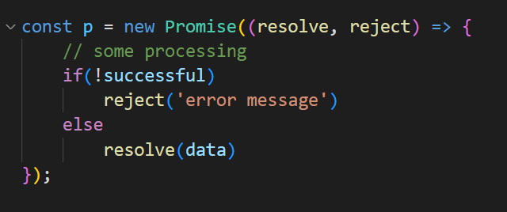
Promise (continued)
Now let’s see how we can write our own Promise.
Care should be taken while writing the promises, because some minor mistake can greatly affect the performance of our program.
It is also very rare to write promises in real application. Generally it is written when we are building some library or converting a API which doesn’t support Promise based approach.
Consider the example written in the code.

Slide 15
Promise (continued)
Promises doesn’t also entirely fix the problem of unreadable code.
It is highly possible that if we are not aware we end up in a callback hell.
Usually async tasks are dependent on one and another.
For example, get data from API endpoint (async task) and then parse that data to JSON (also async task). Since we first need the data to parse it. These both tasks are dependent to one and another.
Javascript provides async and await keywords to address the issue.

Slide 16
Async/await

Slide 17
Async/await
The async function declaration declares an async function.
Where the await keyword is permitted within the function body.
The async and await keywords enable asynchronous, promise-based behavior to be written in a cleaner style, avoiding the need to explicitly configure promise chains.
Async function always returns promise.
It is just a syntax sugar provided by the Javascript. Behind the scenes async await is just promise based implementation.

Slide 18
Eventloops

Slide 19
How does Javascript work?

Slide 20
Javascript is a single threaded non-blocking asynchronous concurrent programming language.

Slide 21
It has call stack, an eventloop a callback queue and some other APIs

Slide 22
And I think I kinda understand this

Slide 23
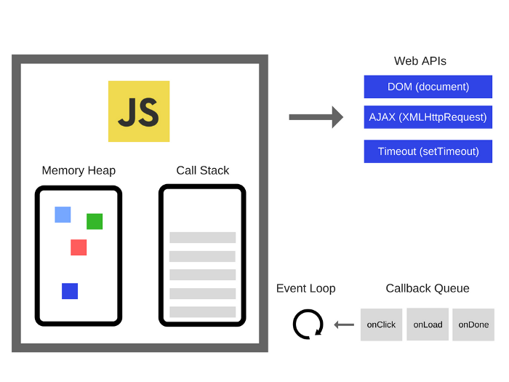

Slide 24
The call stack
One thread, that means only one thing at a time

Slide 25
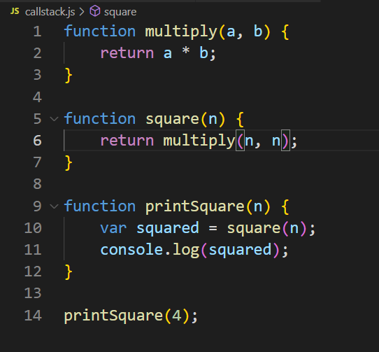
Call stack
Stack

Slide 26
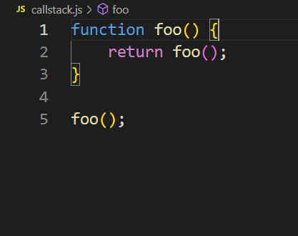
Call stack
Stack
It will throw RangeError: Maximum call stack size exceeded

Slide 27
Blocking
What is blocking and non blocking means?

Slide 28
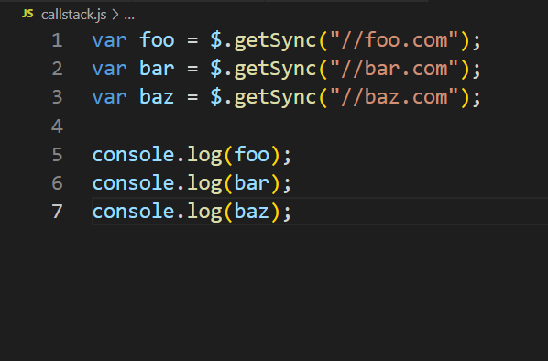
Call stack
Stack
Psudo code to represent a function that makes HTTP request synchronously

Slide 29
So why this is a problem?
Because we are running the code on browsers

Slide 30
Solution?
Asynchronous callbacks

Slide 31
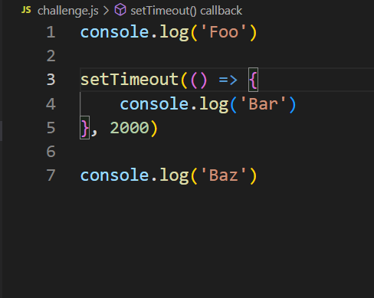
Call stack
Output?

Slide 32
Concurrency & the Event loop
One thing at a time.
Except not really.

Slide 34
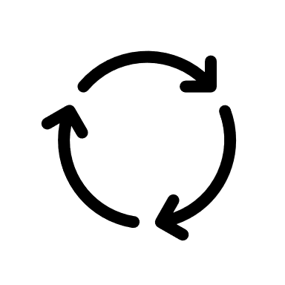
stack
webapis
Console
Event loop
Task queue

Slide 35
setTimeout with 0 ms delay
Why it is helpful?

Slide 36
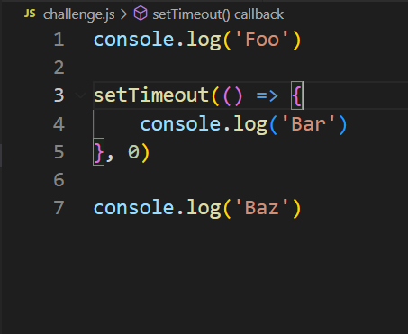
stack
webapis
Console
Event loop
Task queue

Slide 37
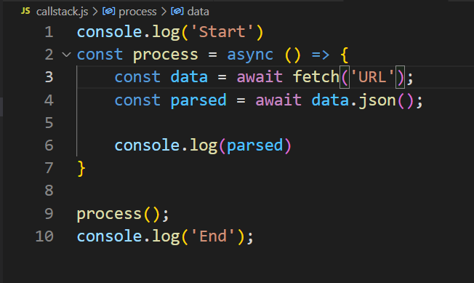
stack
webapis
Console
Event loop
Task queue
Notes:
Give example of onclick event. Onclick listener is running on webapis and when click happens it pushes callback in task queue

Slide 38
Render Queue

Slide 39
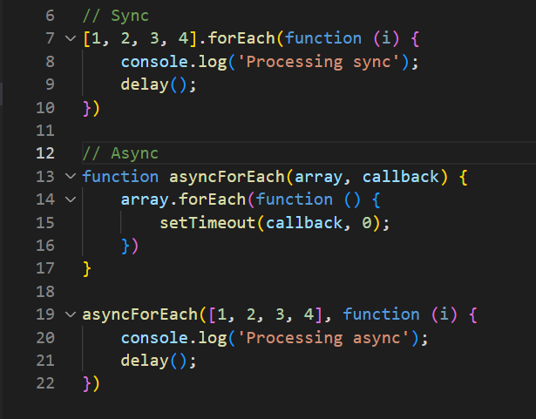
stack
webapis
Event loop
Console
Render queue
Task queue
Notes:
Give example of onclick event. Onclick listener is running on webapis and when click happens it pushes callback in task queue

Slide 40

DON’T BLOCK THE EVENTLOOP

Slide 41
THANK YOU

